Slide 1
5210 Presentation Assignment
Group 9
1
2
3
4
5
difflib
jellyfish
rapidfuzz
fuzzywuzzy
recordlinkage
By Martin
By Yunyu
By Leo
By Yunze
By Heng

Slide 2

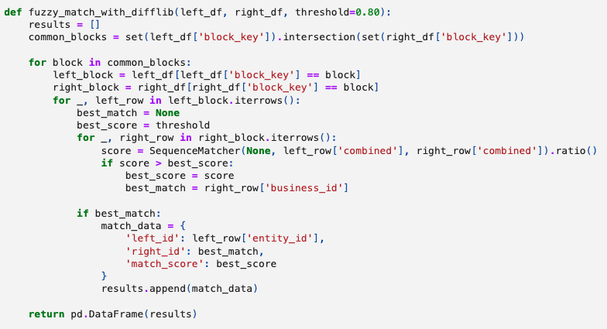
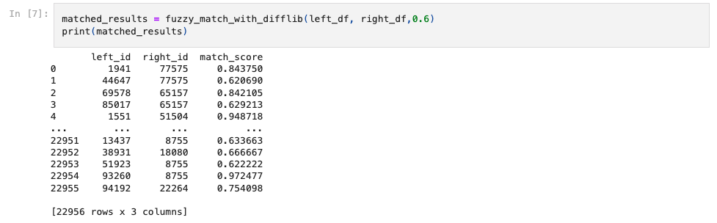
By Martin Ng
A Python library offering tools to compare sequences.
It contains functions to find differences and calculate similarity
Using algorithms like SequenceMatcher
Yield a result of 23k matched pairs in the given dataset. The tested minimum threshold is 0.6
More conservative match approach: longer contiguous matching sequences
=> fewer matches if the matches are not long or contiguous

Slide 3
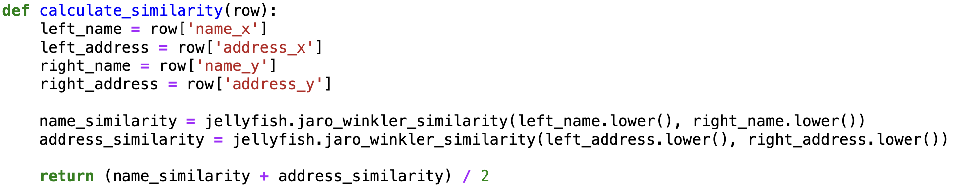
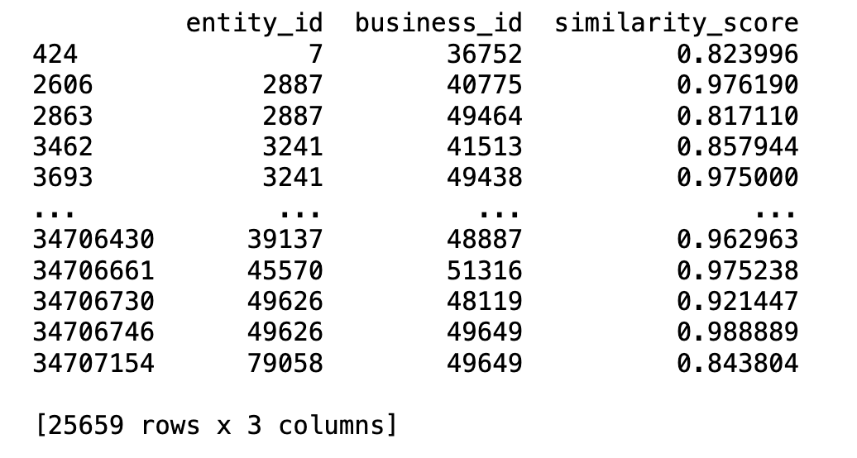
Convert relevant columns to the same data type (e.g., string).
Fill missing values with empty strings.
Create a common field for comparison (e.g., 5 digits zip code).
01
Preparation
02
Function
Setting
Jaro_winkler_similarity: calculate the Jaro-Winkler similarity between two strings.
Jellyfish
Calculate string similarity and distance.
03
Calculation
By Yunyu Huo
04
Output

Slide 4
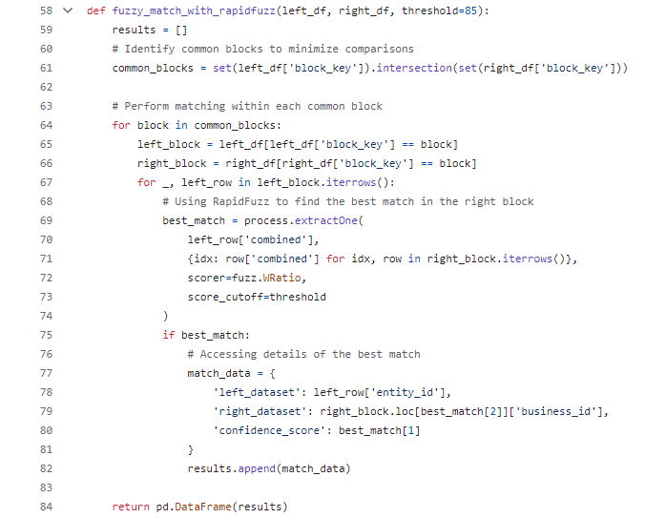

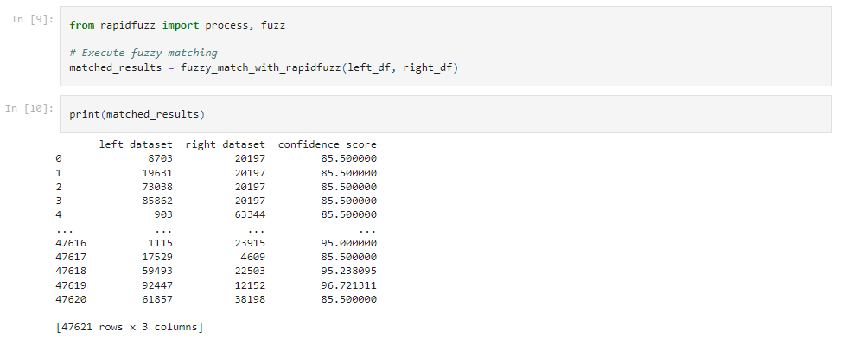
By Leo Zhou
A MIT licensed C++ written package with a lot of algorithmic improvements on top of Fuzzywuzzy.
It contains many string_metrics like hamming or jaro_winkler that is not contained in Fuzzywuzzy.
Using hybrid index blocking for further efficiency enhancement.
Yield a result of 48k matched pairs in the given dataset. The tested minimum threshold is 0.65.

Slide 5
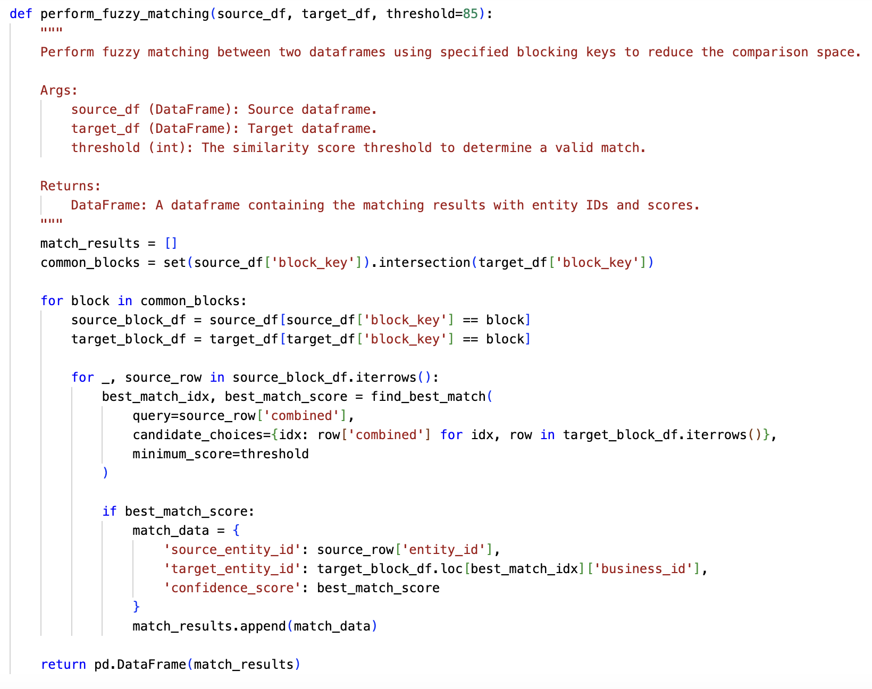
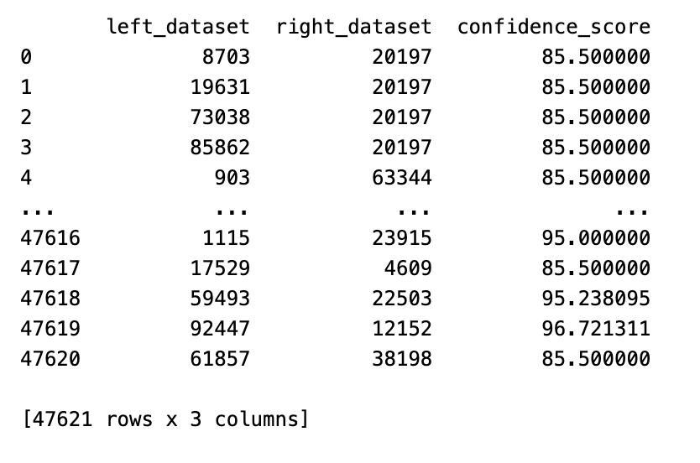
Imports and Exploration
loads two datasets, left_df and right_df
uses the head() method to preview the first few rows of each dataset, allowing the user to get a sense of the data structure and contents.
Fuzzywuzzy
Data Cleaning
By Yunze Dou
Renaming zip_code to postal_code in right_df to match left_df
Dropping Columns: categories, city, state, size are removed from both dataframes
converts text to lowercase, removes leading and trailing spaces, and standardizes postal_code format.
Fuzzy Matching
Results

Slide 6
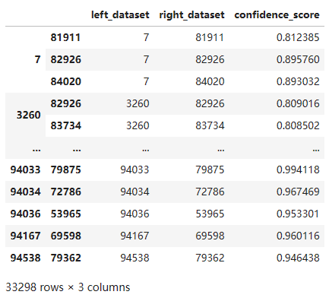
recordlinkage
By Heng Zhu

Slide 7
Thank you for listening

